Slide 1
MICROPROGRAMMED CONTROL
Originally proposed by M. V. Wilkes in 1951
Systematic control logic design method in which control signals are generated using a low-level program (a microprogram) stored in a fast on-chip ROM or RAM(referred to as control memory (CM)).
Useful for designing control logic for microprocessors with extremely large and complex instruction sets.

Slide 2
What is a Microprogram?
Program stored in memory that generates all the control signals required to execute the instruction set correctly
Consists of microinstructions
What is a Microinstruction?
Contains a control word and a sequencing word(address)
Control Word - All the control information required for one clock cycle
Sequencing Word - Information needed to decide the next microinstruction address

Slide 3
Block Diagram
Status signals
Address logic
Control memory
Microinstruc
-tion reg.
Instruction register
Decoder
Control Signals
Control Memory - Storage unit to store the microprogram.
Microinstruction reg. – just like instruction reg.

Slide 4
Advantage:
Micro-programming helps in making control units which may be changed by changing the content of the memory.
Drawback:
But slow due to the fetch timing of the microinstruction from the control memory.
more costly due to the presence of the control memory and its access circuits.
Used in CISC CPU designs
Suitable for highly complex control unit designs

Slide 5
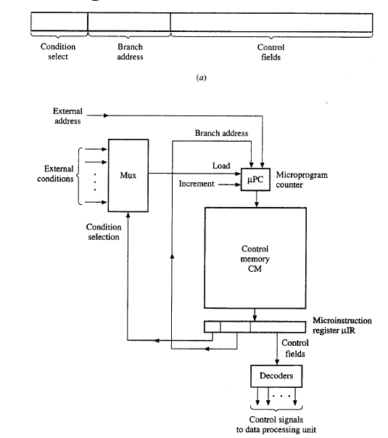

Slide 6
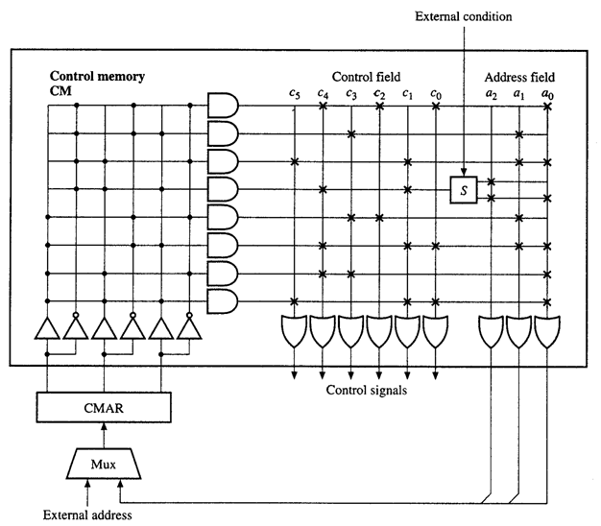
Basic Structure

Slide 7
Microinstruction Formats
Vertical Format(microinstruction)
  Shorter format
  maximal encoding. i.e. Sets of control signals are encoded into control fields.
  More decoding needed to interpret fields. i.e. decoders are used to generate the actual control signals from a specific microinstruction
  Limited ability to express parallelism
  Micro data hardware path more complicated
  Ex: older IBM main frames (IBM 370 model 145)
Micro-instruction Address
Function Codes
Jump
Condition
26年 11月 7日
"Computer Design" by Sunggu Lee

Slide 8
Microinstruction Formats
Horizontal Format(microinstruction)
  Longer format
  Direct relationship between fields/word bits and control signals Control signals are generated directly form the microinstruction (no encoding or decoding is used)
  Micro data hardware path simpler
  High degree of parallel operations possible
  Ex:PowerPC’s employed horizontal code, IBM 360 model 50(90 bits)

Slide 9
Parallelism in μI
If all useful combination of parallel micro-operation are specified by a single opcode.
→ divide the micro-operation specification part into k disjoint control field, any one of which can be performed simultaneously with other.
Un-encoded form (4-bit)
X₀
X₁
X₂
X₃
c₀
c₁
c₂
c₃
Micro-operation
c₀
○
○
○
○
c₁
c₂
c₃
1 0 0 0 R← X₀
0 1 0 0 R← X₁
0 0 1 0 R← X₂
0 0 0 1 R← X₃
0 0 0 0 No op
Register R

Slide 10
Encoded form (3-bit)
K₀
K₁
K₂
Micro-operation
0 0 1 R← X₀
0 1 0 R← X₁
0 1 1 R← X₂
1 0 0 R← X₃
0 0 0 No op
5 operations
n independent control signal → ⌈log₂(n+1)⌉ bits decoder is needed

Slide 11
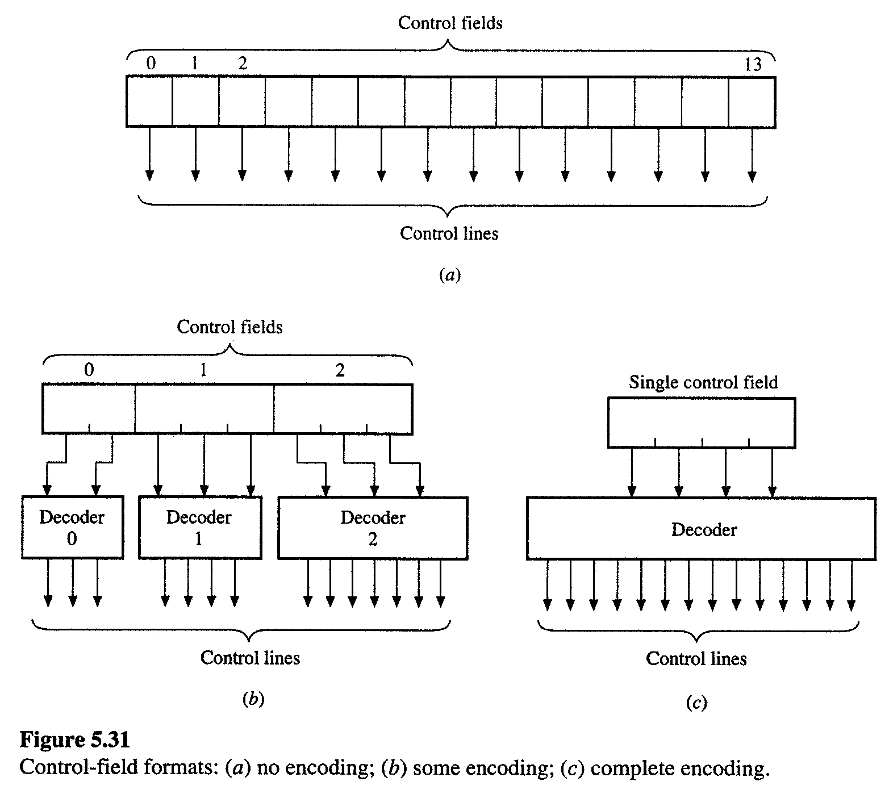
b)⇒ achieve the minimum number of bits in the control field maintaining the parallelism

Slide 12
Micro-operation Timing
– monophase : a simple clock pulse synchronize all the control signals.
control signals are active for the duration of instruction’s execution cycle
– polyphase : divide a clock cycle into phases and control signal is active
during one of the phase Increase the complexity of the μI
format
(to specify the phase of which control signal)

Slide 13
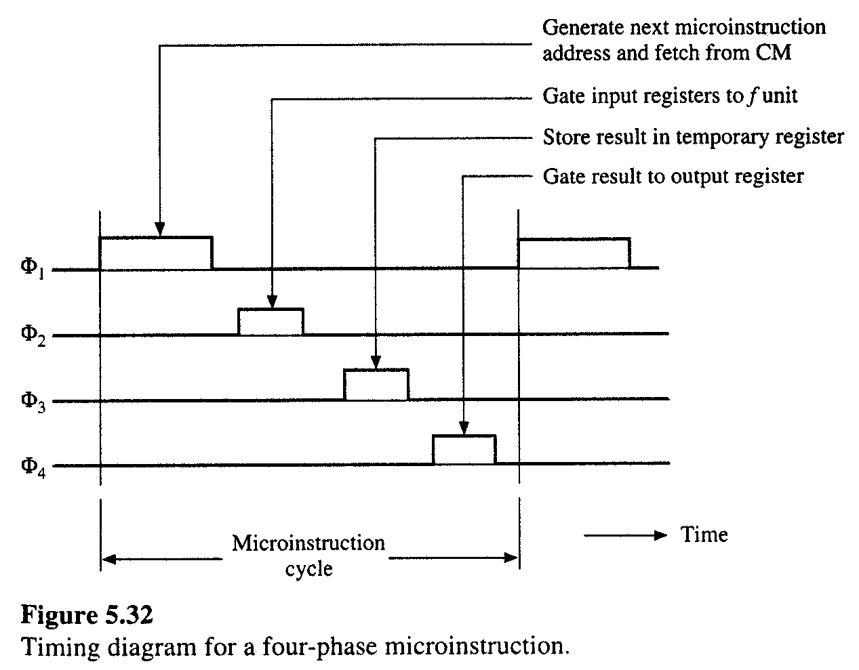
Ex) Timing of 4-phase μI. ( R ← R₁ op R₂ )

Slide 14
Micro-program Word Length
Micro-instruction Word Length is determined based on 3 factors:
  Maximum number of simultaneous micro-operations supported
  The way in which the control information is represented or encoded
  The way in which the next micro-instruction address is specified
Notes:
TK2123
Dr Masri Ayob

Slide 15
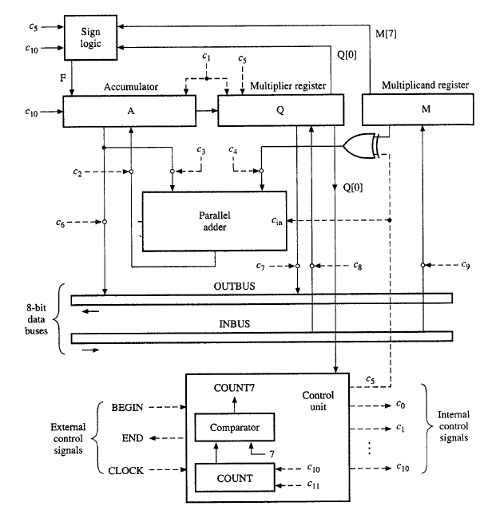
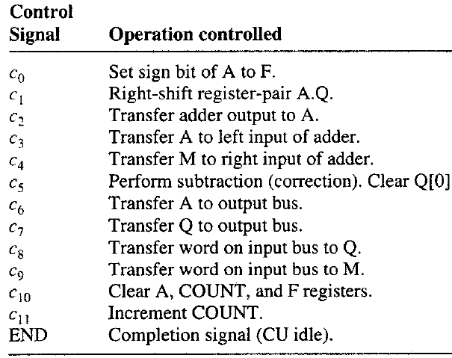
Twos-complement multiplier
Computer architecture and organisation

Slide 16
Multiplier- Microprogramming control
Condition select field
No Branching (00)
Branch if Q[0]=0 (01)
Branch if Count≠7 (10)
Unconditional Branch (11)
Hence a 2-bit conditional select field is needed.
Branch address field - 4 bits
- There are 10 states, so 4 bits are enough to encode the states.
Control field - 13 bits
Notes:
-

Slide 17
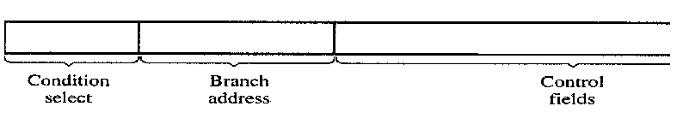
Microinstruction length
Horizontal
2-bits
4 bits
13 bits
Micro instruction length – 19 bits

Slide 18
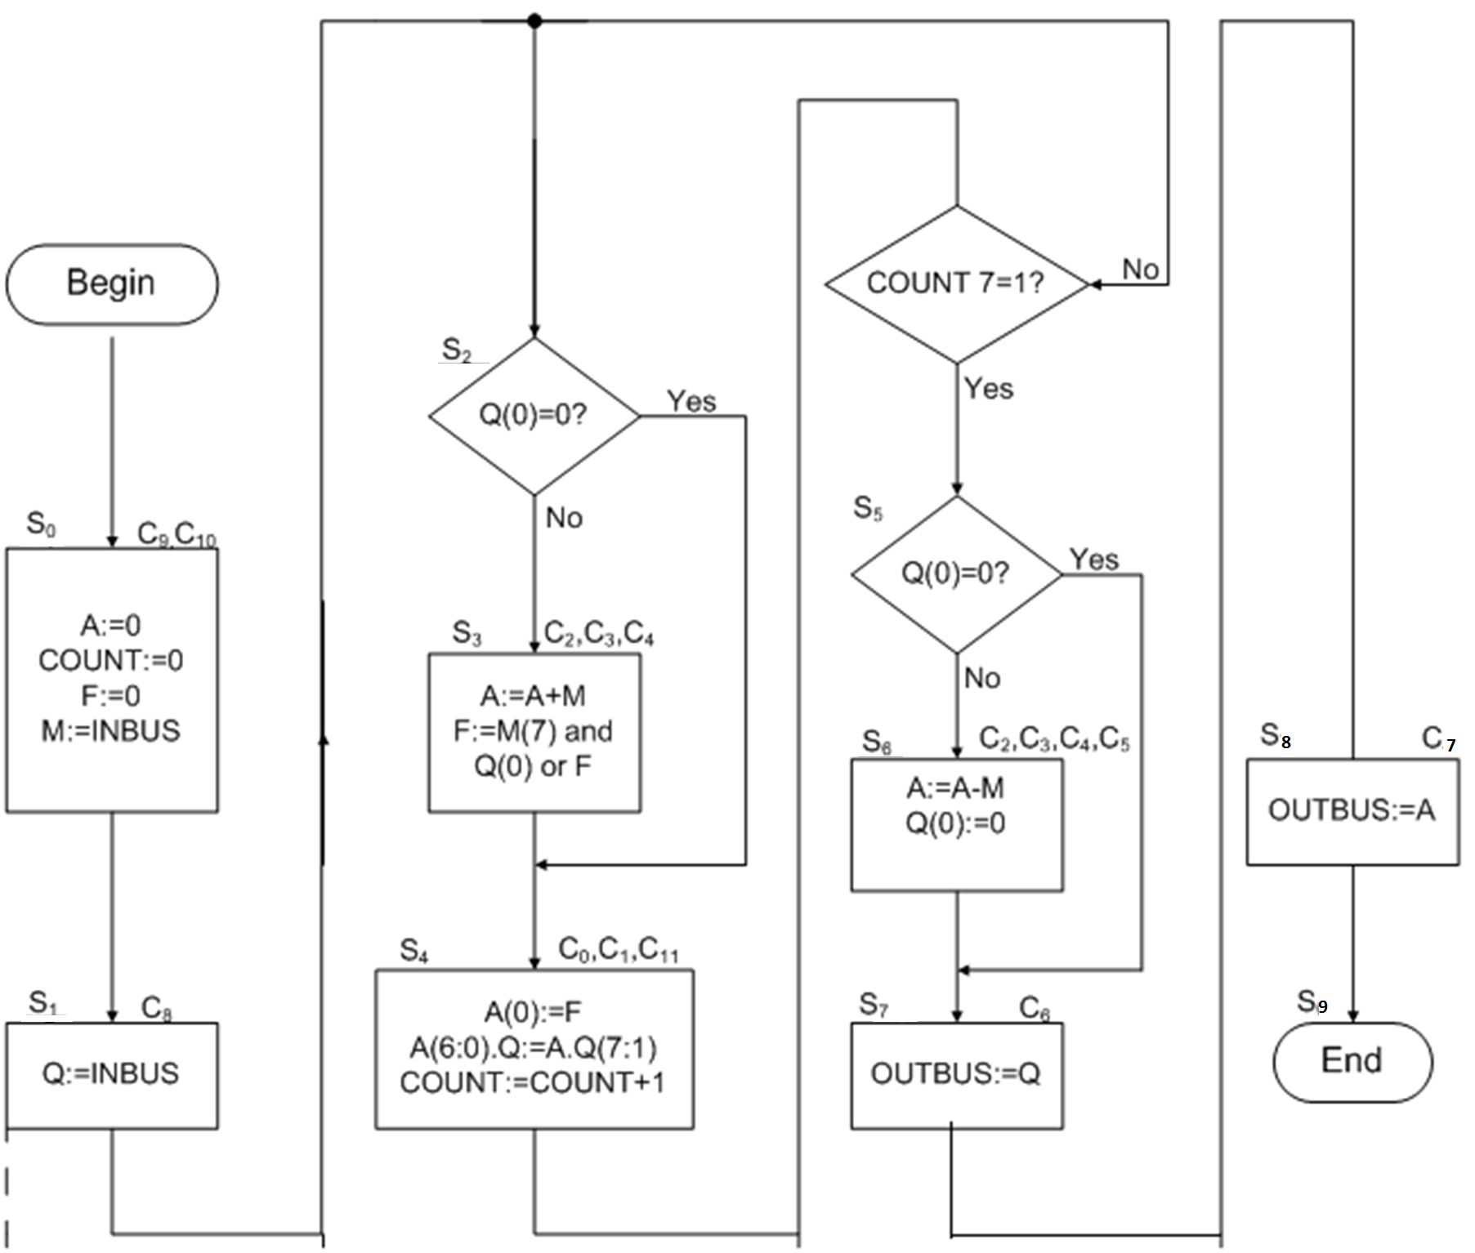
MULTIPLIER CONTROL UNIT - Microprogramming control
No. of Microinstruction needed - 10
Computer architecture and organisation

Slide 19
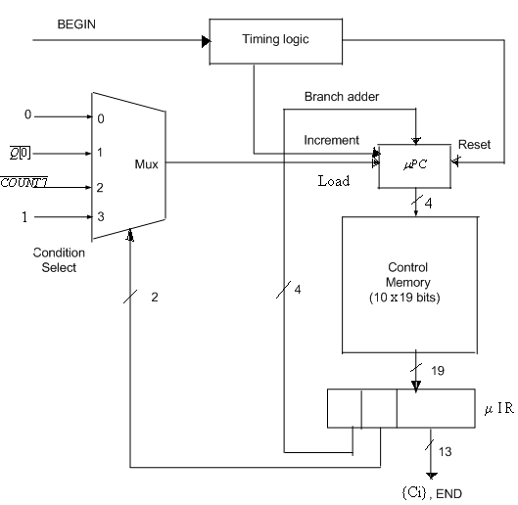
Multiplier- Microprogramming control

Slide 20
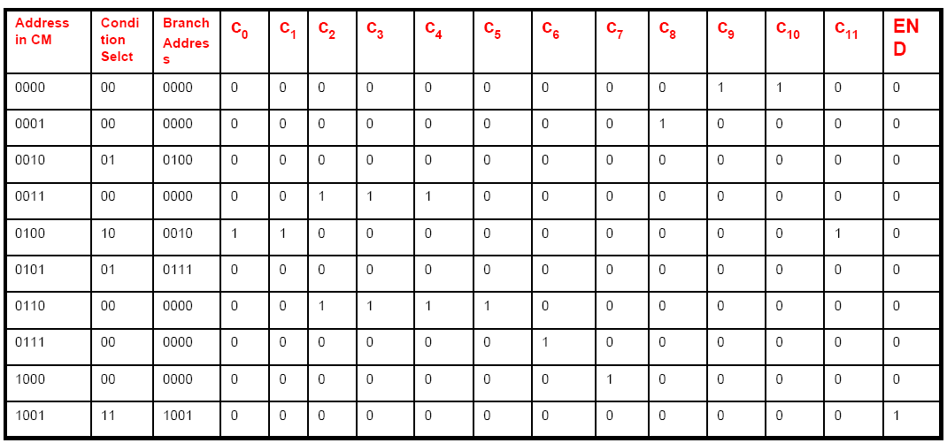
Binary Microprogram

Slide 21
Minimizing the width of microinstruction
Methods of reducing the width of Microinstruction
Based on Maximal compatibility class (MCC)
Encoding by function
Multiple instruction format

Slide 22
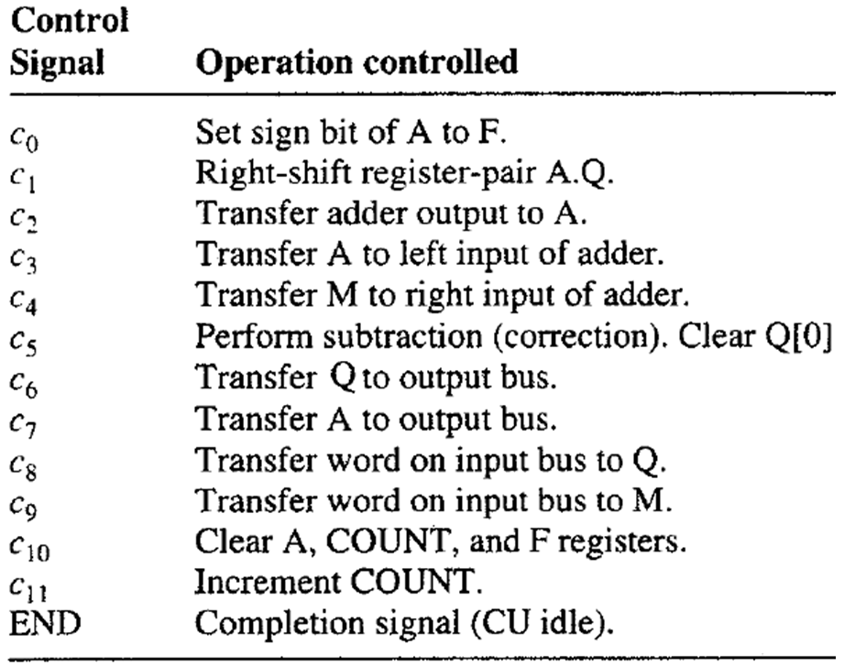
Removing redundant control fields
13 11 7 0
Condn Branch address c₀ c₂ c₅ c₆ c₇ c₈ c₉ End
Select c₁ c₃ c₂ c₁₀
c₁₁ c₄ c₃
c₄

Slide 23
Based on Maximal compatibility class (MCC)
After removing redundant control signals,
Microinstruction Length is reduced from 19 bits to 14 bits
13 11 7 0
Condn Branch address c₀ c₂ c₅ c₆ c₇ c₈ c₉ End
Select

Slide 24
Based on Maximal compatibility class (MCC)
Algorithm
1. Find the set of Maximal compatibility class (MCC), defined as the compatibility
classes to which no control signal can be added without introducing a pair of
incompatible control signals.
- Two control signals can be included in the same control field iff
they are never simultaneously activated by a μI. (i.e. they are compatible).
- Two control signals C_{i1} and C_{i2} are compatible if C_{i1}∈I_{j} implies C_{i2}∈I_{j}, and vice
versa. The compatibility class is a set of control signals that are pairwise compatible.
2. Determine all minimal MCC covers. A minimal MCC cover is the minimal set of
MCC that includes each control signal. ( Note that a minimal MCC cover does not
always yield a minimum value of the cost function W ).
3. For each minimal MCC covers, include each control signal in exactly one subset of
some {C_{i}} and execute the cost W of the resulting solutions and select one with the
minimal cost.
The minimization problem: Find a set of compatibility class {C_{i}} such that 1. Every control signal is contained in at least one {C_{i}}.
2. The width W = ∑ ⎡log₂( |C_{i}| + 1 )⎤ is minimized.

Slide 25
Maximal compatibility class (MCC)
C0 = {c_{0,} c_{2,} c_{6,}c₇,c_{8,}c_{9,} End}
C1 = {c_{0,} c_{5,} c_{6,}c₇,c_{8,}c_{9,} End}
Minimum set of compatibility class {C_{i}}
C0’ = {c_{0,} c_{2,} c₆} W = log₂(3+1)+
C1’ = {c_{5,}c₇,c_{8,}c_{9,} End} log₂(5+1)
= 5
Find a set of compatibility class {C_{i}} such that
1. Every control signal is contained in at least one {C_{i}}.
2. The width W = ∑ ⎡log₂( |C_{i}| + 1 )⎤ is minimized.

Slide 26
Vertical format
Control field
⇒ achieve the minimum number of bits in the control field maintaining the parallelism
decoder 1
decoder 2
10 8 4 0
Condn Branch address Control Field (Encoded form)
Select
Vertical Micro instruction length = 11 bits

Slide 27
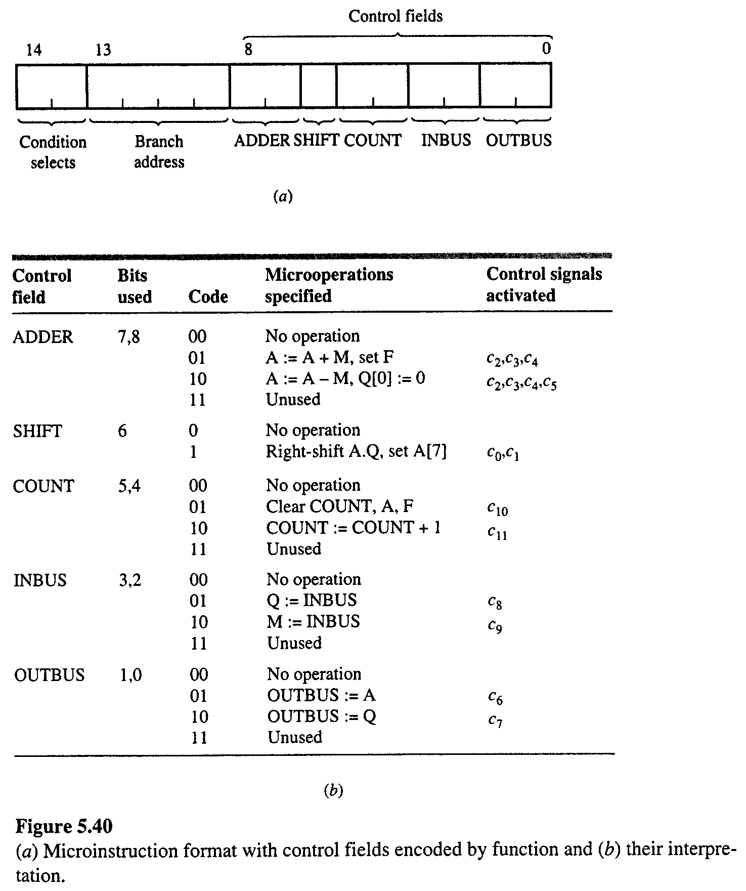
Encoding by function
A drawback of the minimum-width control field : functionally unrelated control signals are combined.

Slide 28
Multiple μ-Instruction formats
- Branch instructions which specify no control signals.
- Action instructions with no branching capability.
This approach is used at the instruction level.
Formats
Control fields
0 0
Action μ-Instruction
Condition select
Branch address
Branch μ-Instruction
0 1 if Q(7) = 0
1 0 if COUNT6 = 1
1 1 jump

Slide 29
CM contents based on Multiple μ-Instruction formats (Width – 10 bits)
Addr in CM | Condn.select | Control field
 |  | C0 | C2 | C5 | C6 | C7 | C8 | C9 | END
0000
0001
0010
0011
0100
0101
0110
0111
1000
1001
1010
1011
bit → | 9 8 | 7 | 6 | 5 | 4 | 3 | 2 | 1 | 0

Slide 30
CM contents based on Multiple μ-Instruction formats
Addr in CM | Condn.select | Control field
 |  | C0 | C2 | C5 | C6 | C7 | C8 | C9 | END
0000 | 00 | 0 | 0 | 0 | 0 | 0 | 0 | 1 | 0 | active
0001 | 00 | 0 | 0 | 0 | 0 | 0 | 1 | 0 | 0 | active
0010 | 01 | 0 | 0 | 0 | 0 | 0 | 1 | 0 | 0 | branch
0011 | 00 | 0 | 1 | 0 | 0 | 0 | 0 | 0 | 0 | active
0100 | 00 | 1 | 0 | 0 | 0 | 0 | 0 | 0 | 0 | active
0101 | 10 | 0 | 0 | 0 | 0 | 0 | 0 | 1 | 0 | branch
0110 | 01 | 0 | 0 | 0 | 0 | 1 | 0 | 0 | 0 | branch
0111 | 00 | 0 | 1 | 1 | 0 | 0 | 0 | 0 | 0 | active
1000 | 00 | 0 | 0 | 0 | 1 | 0 | 0 | 0 | 0 | active
1001 | 00 | 0 | 0 | 0 | 0 | 1 | 0 | 0 | 0 | active
1010 | 00 | 0 | 0 | 0 | 0 | 0 | 0 | 0 | 1 | active
1011 | 11 | 0 | 0 | 0 | 0 | 1 | 0 | 1 | 1 | branch
bit → | 9 8 | 7 | 6 | 5 | 4 | 3 | 2 | 1 | 0

Slide 31
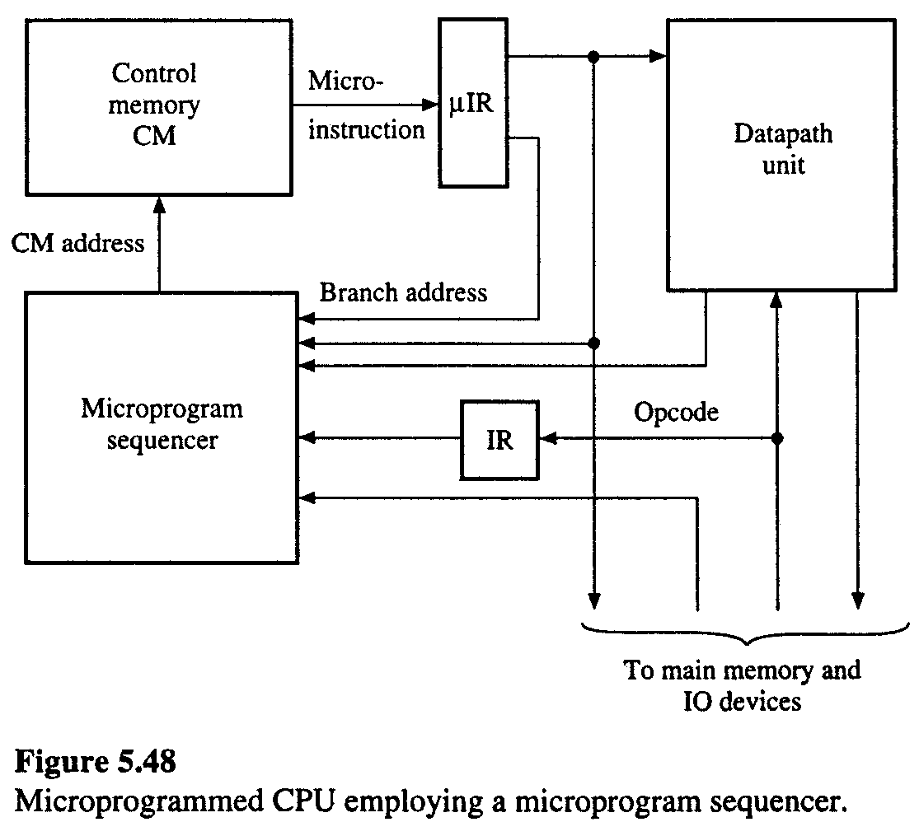
Microprogram sequencer
: to place all the circuitry required to generate μI addresses in a single IC with the advance of VLSI.
– a general purpose building block for μ-programmed CU. – simplify CPU design.

Slide 32
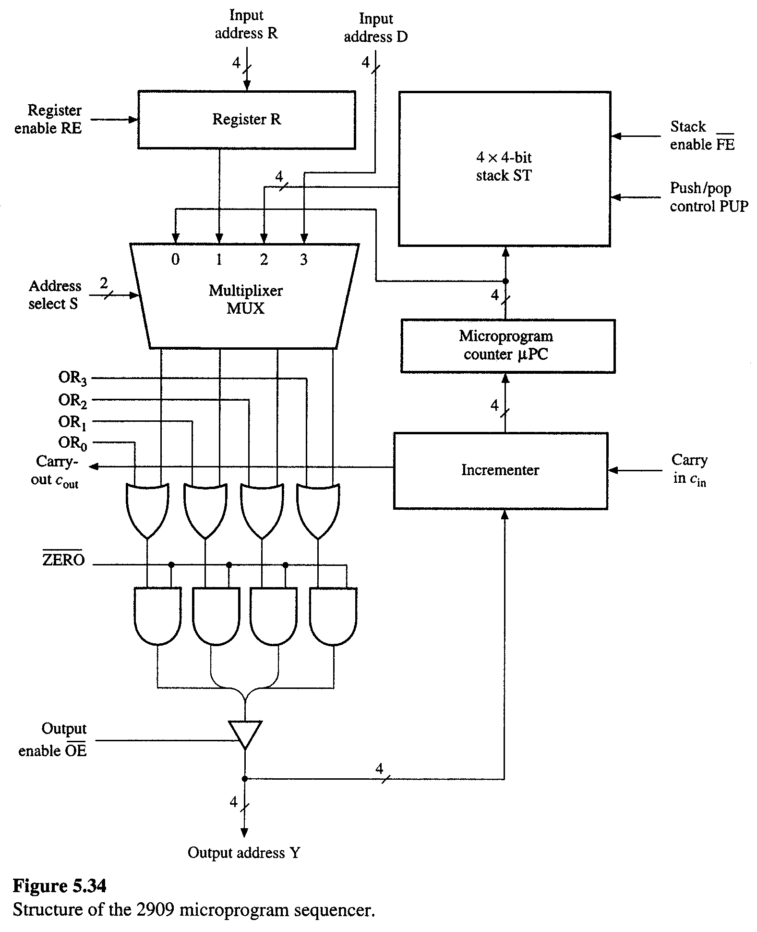
A microprogram sequencer generates
a μI addresses for CM and comprises μPC
and all the logics needed for next address generation

Slide 33
• Nanoprogramming Concept – first used in QM-1 computer
Instruction
μPC
μ-programmed Computer
μCM
μIR
Control
signals
Instruction
nanoprogrammed Computer
μPC
nPC
μCM
μIR
nCM
nIR
Control signals
Criteria
① Size of CM
② Speed reduction(μprogramming needs fetch one time / nanoprogramming twice) – due to extra memory access and complex controller.
③ The advantage of nanoprogramming is the greater design flexibility

Slide 34
(Compare the size of CM)
Size of control memory in nanoprogramming
Wm
μCM:
⇒Hm×Wm
Hm
Usually, Hm large Wm small
Hn small & Wn large
Wm
nCM:
Hn
⇒Hn×Wn
Total size : Hm×Wm+Hn×Wn = S₂ ≈ Hm × Wn
Size of comparable single-level μCM
Wm
⇒Hm×Wm = S₁
Hm
Hence S₂< S₁

Slide 35
Big adv. of nanoprogramming “Design flexibility”
1-level μCM
Wm
Hm
size = Hm × (⎡log₂Hm⎤ + N ) =S₁
⎡log₂Hm⎤
N
address
Control signal
Nanoprogramming
μCM
nCM
Hm
⎡log₂Hm⎤
⎡log₂Hn⎤
Hn
N
address
address
Assuming no branching
S₂ = Hm × (⎡log₂Hm⎤ + ⎡log₂Hn⎤) + Hn × N
Let, r = Hn/Hm = ratio of unique nano-control states to total # of μ-control states for all instructions. Hn = r·Hm
S₂ = Hm × (⎡log₂Hm⎤ + ⎡log₂r·Hm⎤) + r·Hm × N = Hm ( 2· ⎡log₂Hm⎤ +⎡log₂r⎤ + r·N )

Slide 36
Example) For 68000 μProcessor(N = 70, Hm = 650, r = 0.4), which approach is better?
1-level CM design (μ-programming):
S₁ = 650 × (⎡log₂650⎤ + 70) = 52,000
70
650
⎡log₂650⎤
Nanoprogramming
S₁ = 650 × (⎡log₂650⎤ + ⎡log₂260⎤ )+ 260 × 70 = 30,550
70
650
260
⎡log₂650⎤
⎡log₂260⎤
In this case, nanoprogramming is better than microprogramming

